Slide 1

RLDWIDE PHENOMENA

Slide 2
Environmental Problems

Slide 3
Environmental Problems
in Bangladesh

Slide 4

Environmental Problems
in Bangladesh

Slide 5


Environmental Problems
in Bangladesh

Slide 6
Environmental Problems
in Bangladesh

Slide 7
Environmental Problems
in Bangladesh

Slide 8




Environmental Problems
| Causes of Environment Degradation
three major interlinked causes
in Bangladesh

Slide 9

Overpopulation |
Overpopulation is defined as the condition of having a population so dense as to cause environmental deterioration, an impaired quality of life, or a population crash. The rapid population growth and economic development in country are degrading the environment through the uncontrolled growth of urbanization and industrialization, expansion and intensification of agriculture and the destruction of natural habitats. One of the significant reasons for environmental degradation in Bangladesh could be ascribed to quick development of population which is antagonistically influencing the natural resources and condition. The current population of Bangladesh is 164,725,975 and with a rank of eighth by population with a critical density of 1265 per square km.

Slide 10
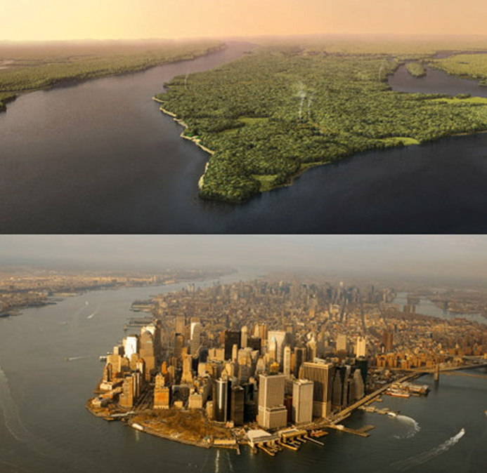
Urbanization |
Urbanization refers to the population shift from rural to urban areas, the decrease in the proportion of people living in rural areas, and the ways in which societies adapt to this change. It is predominantly the process by which towns and cities are formed and become larger as more people begin living and working in central areas. Lack of opportunities for gainful employment in villages and the ecological stresses is leading to an ever-increasing movement of poor families to towns. Such fast and spontaneous extension of urban areas has brought about debasement of urban condition. It has extended the hole amongst request and supply of infrastructural administrations, for example, vitality, lodging, transport, correspondence, instruction, water supply and sewerage and recreational pleasantries, along these lines exhausting the valuable ecological asset base of the urban areas.

Slide 11
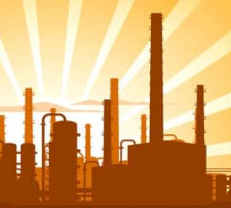
Industrialization |
Industrialization is the period of social and economic change that transforms a human group from an agrarian society into an industrial society. This involves an extensive reorganization of an economy for the purpose of manufacturing. Industrialization has brought economic prosperity; additionally, it has resulted in more population, urbanization, obvious stress on the basic life supporting systems while pushing the environmental impacts closer to the threshold limits of tolerance. With booming industrial growth and relatively low land mass, environmental degradation is biggest negative effect of industrial development process. Pollution is the most common byproduct of industrialization.

Slide 12
Environmental Problems
| Causes of Environment Degradation
three major interlinked causes
in Bangladesh

Slide 13

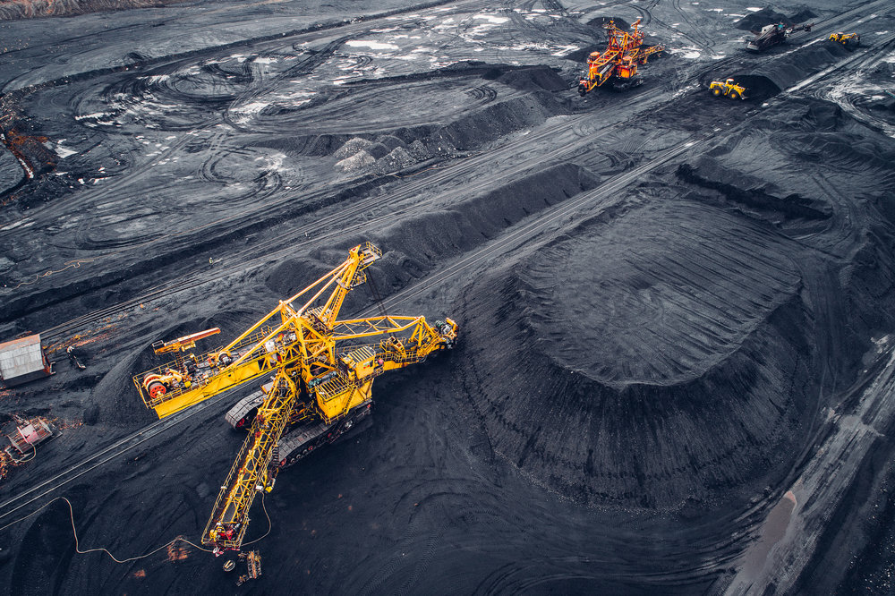
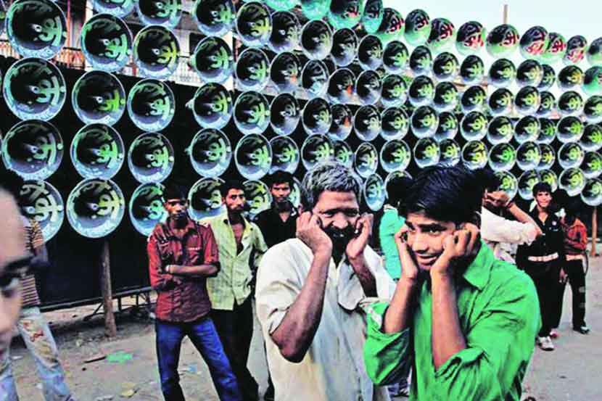
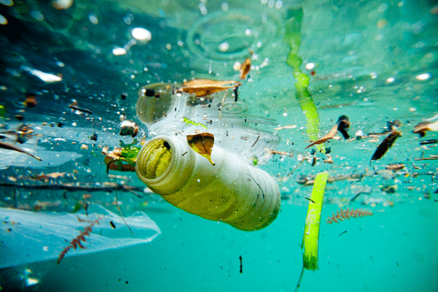
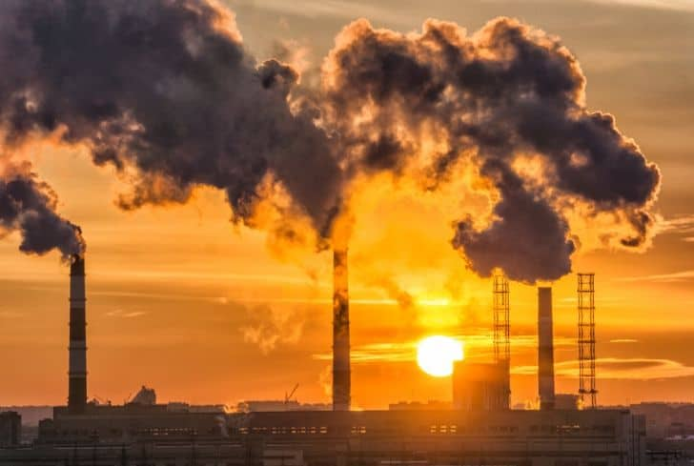
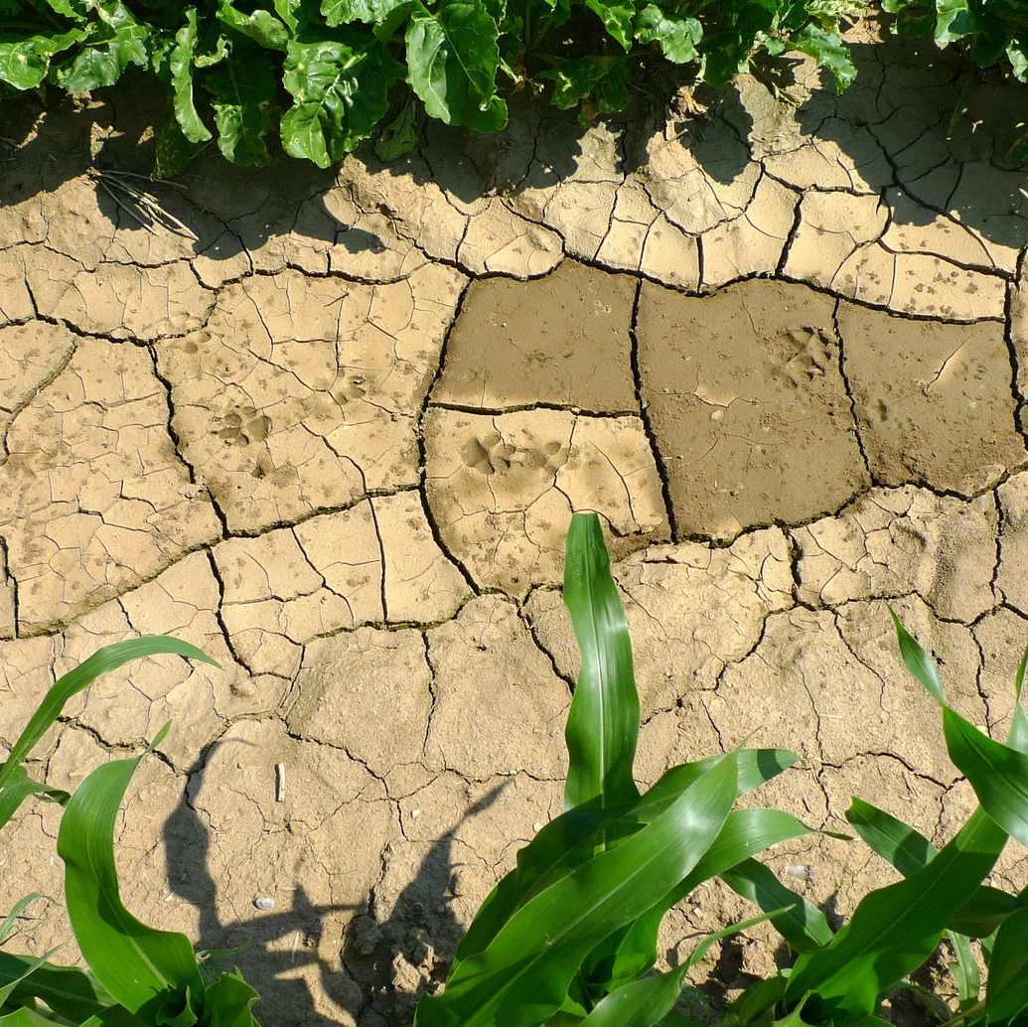
Environmental Problems
| How Environment is Degrading
in Bangladesh

Slide 14
Environmental Problems
| Causes of Environment Degradation
How Environment is Degrading
in Bangladesh
Land Degradation
Land degradation is any change or disturbance to the land perceived to be undesirable. Land degradation can be caused by both manmade and natural reasons such as floods and forest fires.

Slide 15
Environmental Problems
| Causes of Environment Degradation
How Environment is Degrading
in Bangladesh
Air Pollution
Air pollution in Bangladesh is a serious issue with the major sources being fuel wood and biomass burning, fuel adulteration, vehicle emission and traffic congestion.

Slide 16
Environmental Problems
| Causes of Environment Degradation
How Environment is Degrading
in Bangladesh
Water Pollution
Water pollution is the contamination of water bodies, usually as a result of human activities. Water bodies include for example lakes, rivers, oceans, aquifers and groundwater.

Slide 17
Environmental Problems
| Causes of Environment Degradation
How Environment is Degrading
in Bangladesh
Sound pollution
Noise pollution is generally defined as regular exposure to elevated sound levels that may lead to adverse effects in humans or other living organisms.

Slide 18
Environmental Problems
| Causes of Environment Degradation
How Environment is Degrading
in Bangladesh
Depletion of Resources
Resource depletion is the consumption of a resource faster than it can be replenished. Natural resources are commonly divided between renewable resources and nonrenewable resources.

Slide 19
Environmental Problems
| Causes of Environment Degradation
How Environment is Degrading
in Bangladesh
Light pollution
Light pollution is the presence of anthropogenic and artificial light in the night environment. It is exacerbated by excessive, misdirected or obtrusive use of light, but even carefully used light fundamentally alters natural conditions.

Slide 20

Environmental Problems
in Bangladesh
| Environmental Concerns in Bangladesh
“around 234,000 deaths, including 80,000 in urban areas, due to environmental pollution and related health risks in 2015 “

Slide 21
Environmental Problems
in Bangladesh
| Environmental Concerns in Bangladesh
“Dhaka city in 2015 – the second least livable city ”

Slide 22
Environmental Problems
in Bangladesh
| Environmental Concerns in Bangladesh
Jeopardized public health due to particulate air pollution
Loss of significant amount of water resources
Groundwater contamination by trace elements
Biodiversity depletion (Chalan Beel, Sundarbans, Modhupur forest and Chokoria mangrove forest)
Reduction of fertility and cultivable lands due to heavy metalloid contamination in soil
Increase in natural disasters due to climate change

Slide 23
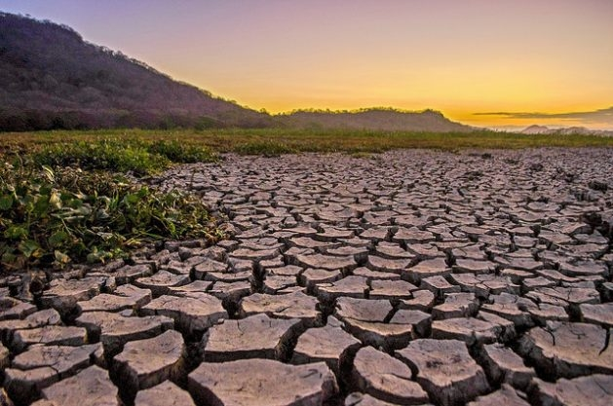
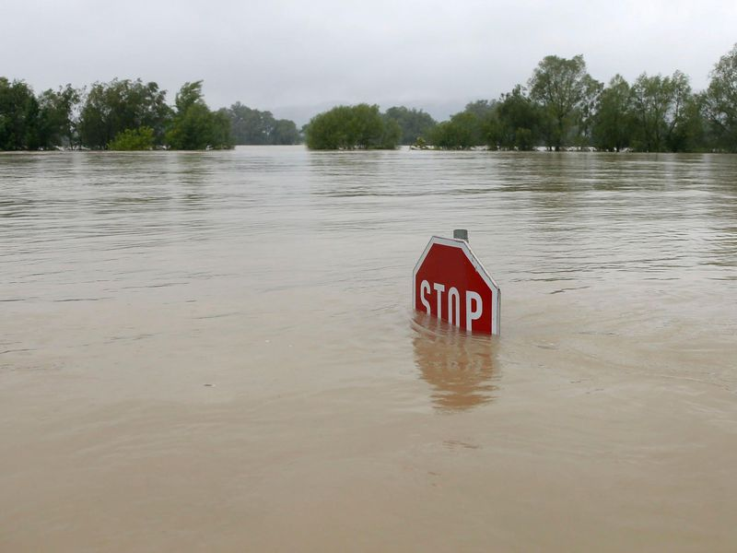
Environmental Problems
in Bangladesh
| Environmental Concerns in Bangladesh
Increase in natural disasters due to climate change

Slide 24
Environmental Problems
in Bangladesh
| Environmental Concerns in Bangladesh
Increase in natural disasters due to climate change

Slide 25
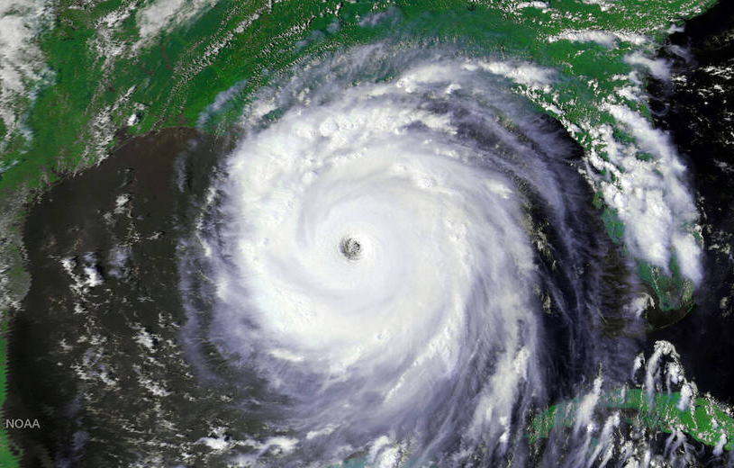
Environmental Problems
in Bangladesh
| Environmental Concerns in Bangladesh
Increase in natural disasters due to climate change

Slide 26
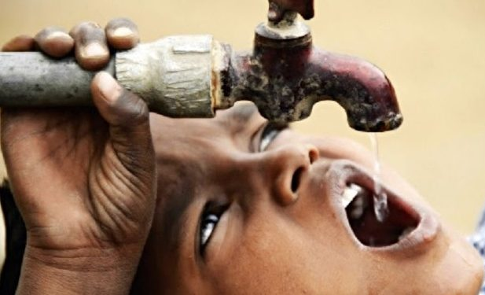
Environmental Problems
in Bangladesh
| Environmental Concerns in Bangladesh
Increase in natural disasters due to climate change

Slide 27
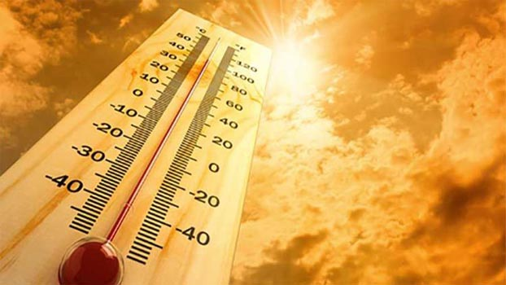
Environmental Problems
in Bangladesh
| Environmental Concerns in Bangladesh
Increase in natural disasters due to climate change

Slide 28
Environmental Problems
in Bangladesh
| Environmental Concerns in Bangladesh
Increase in natural disasters due to climate change

Slide 29
Environmental Problems
in Bangladesh
| Environmental Concerns in Bangladesh
Increase in natural disasters due to climate change

Slide 30
Environmental Problems
in Bangladesh
| Effects of Global Problems in Bangladesh

Slide 31
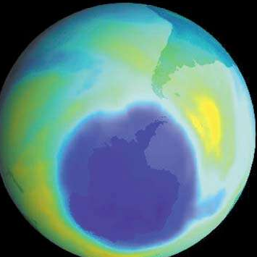
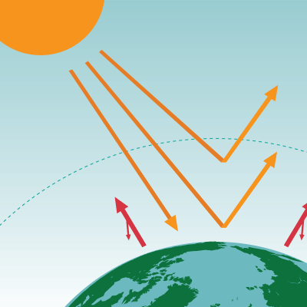

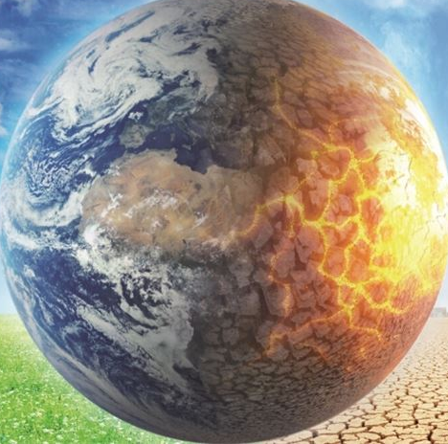
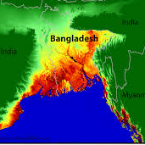
Environmental Problems
| Effects of Global Problems in Bangladesh
in Bangladesh
Ozone Depletion
Greenhouse Effect
Global Warming
Methene
CFC
Carbon Dioxide
Ozone
CFC

Slide 32
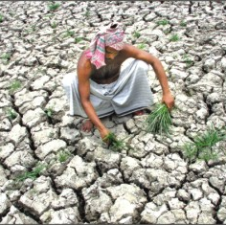
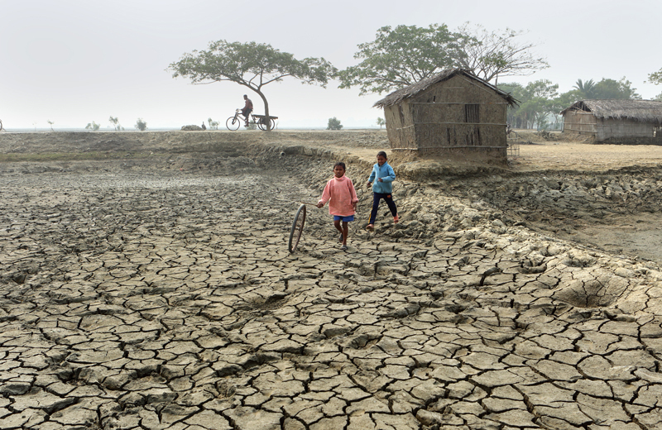
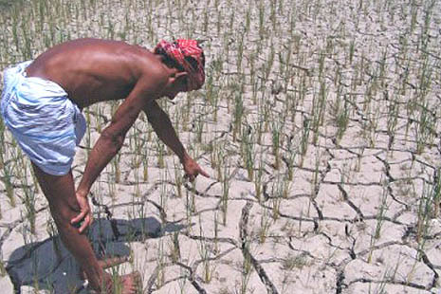
Environmental Problems
| Effects of Global Problems in Bangladesh
in Bangladesh

Slide 33
Environmental Problems
in Bangladesh
| Effects of Global Problems in Bangladesh

Slide 34
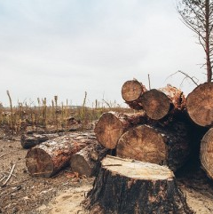
Environmental Problems
in Bangladesh
| Effects of Global Problems in Bangladesh

Slide 35
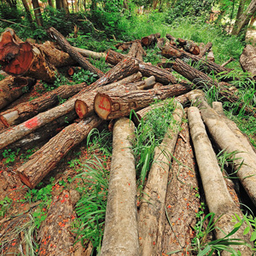
Environmental Problems
in Bangladesh
| Effects of Global Problems in Bangladesh

Slide 36
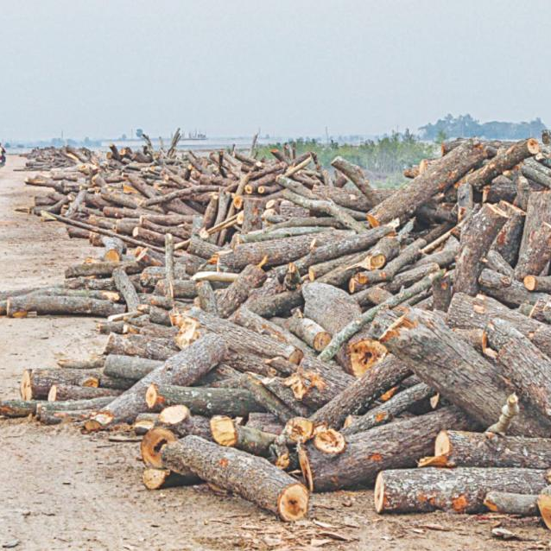
Environmental Problems
in Bangladesh
| Effects of Global Problems in Bangladesh

Slide 37

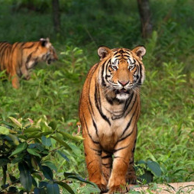
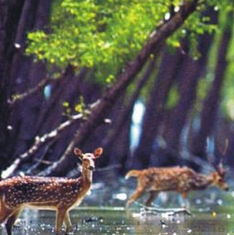

Environmental Problems
in Bangladesh
| Effects of Global Problems in Bangladesh

